Slide 2
Having A Hard Time Finding A Roomie?
Having A Hard Time Finding A Home?
Notes:
Are you having a hard time finding a home?
Are you having a hard time finging a roomie?

Slide 3

We have a solution!
SWIPEMYROOMIE
Notes:
We have just the solution for you!
SwipeMyRoomie!
This website will help you find the perfect house and roommate in Singapore.

Slide 4
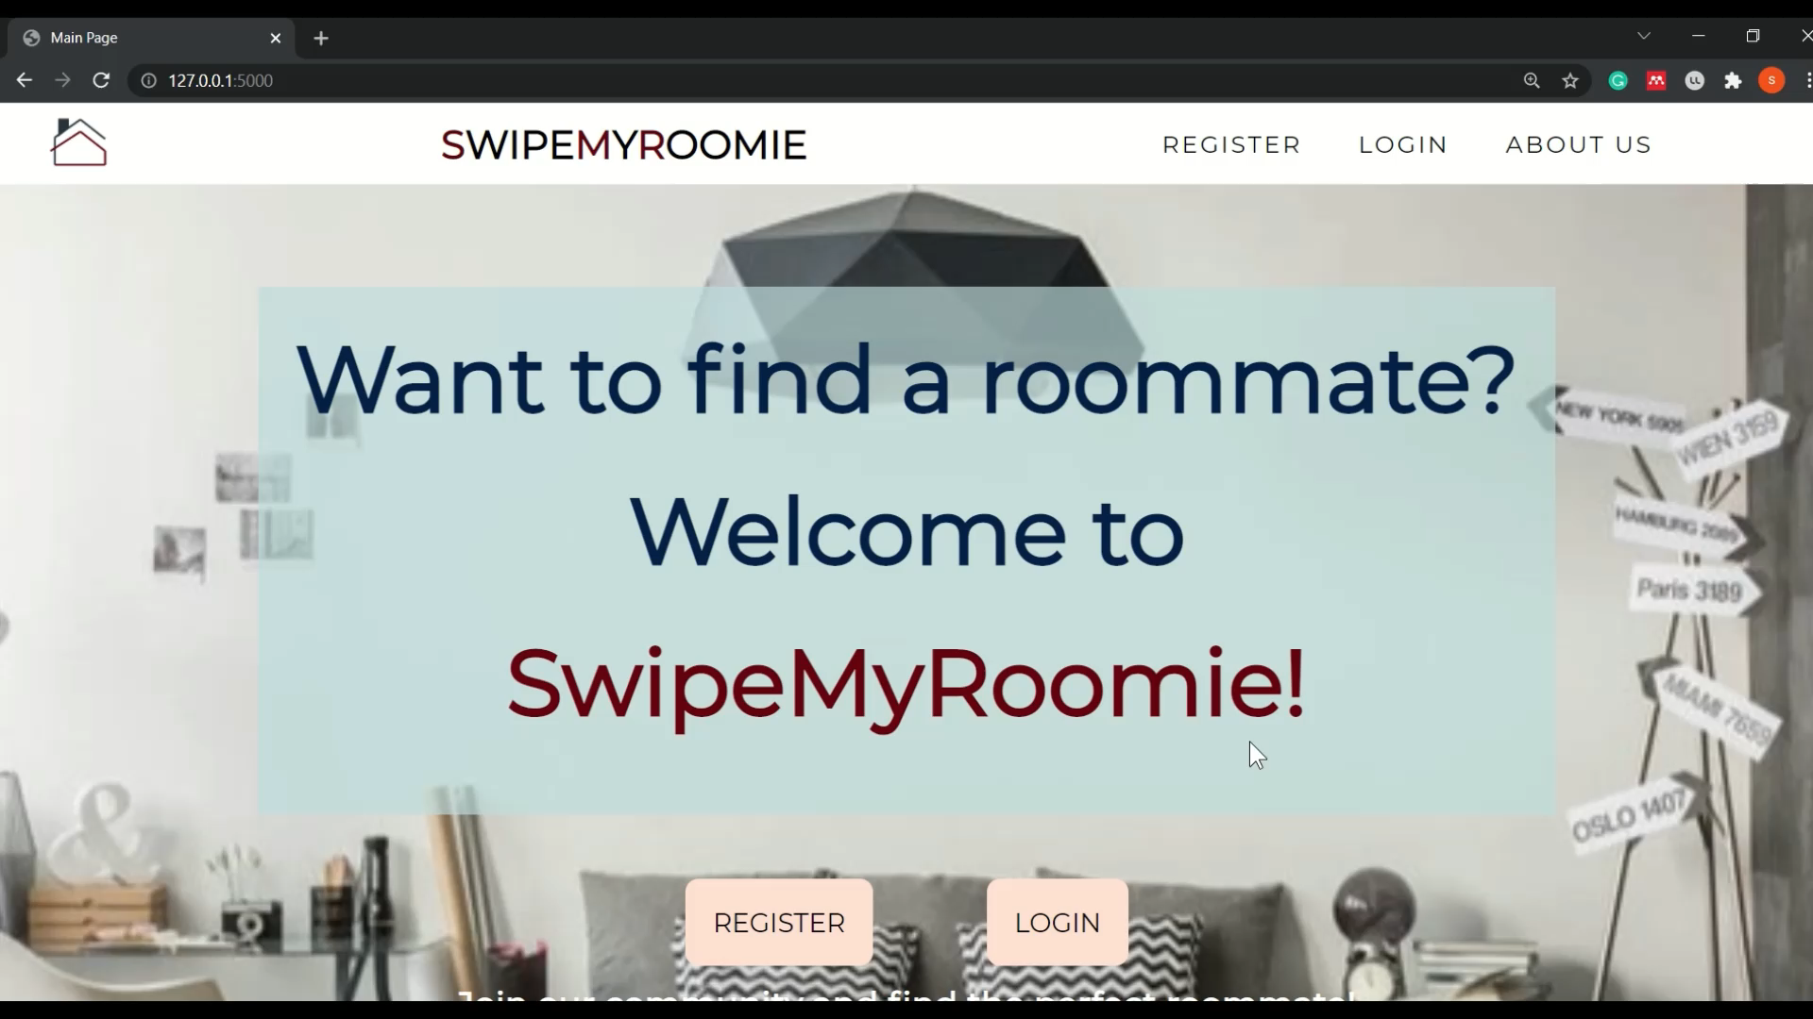

Are You a New User?
Let’s Register a New Account!
Notes:
Are you a new user?
Well, then let’s get you registered!
When you click on our website, you will land on this main page. When you click the register page, you can type in your email and password. You have to also confirm the password. If you entered the a mismatched password, it will prompt you to enter your details again.
Once you have entered the correct password, and you are successfully registered, you are redirected to update your profile.
Here you can enter your name, your age using the up and down buttons, your occupation. You can also enter your gender and language using the dropdown options provided. You can even select a profile image for your account. Thereafter, you can click submit.
The updated details are shown in the profile page.
You can also update your roommate preferences.
The updated roommate preferences are depicted in the profile page.

Slide 5
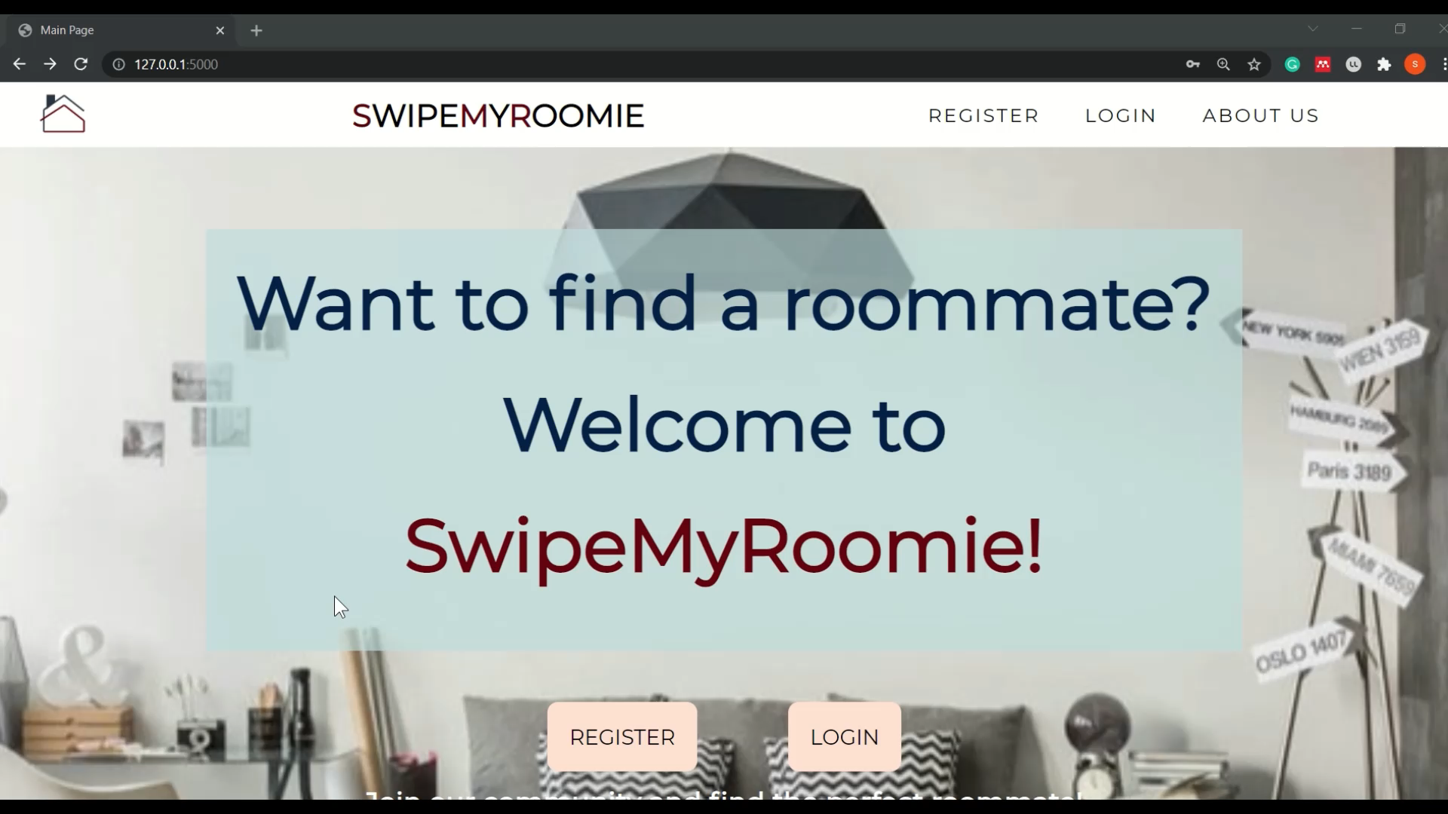
Let’s Login For a Pre-Existing User!
Notes:
Now lets login for a pre existing user!
When the user enters a wrong password, they are prompted to enter the correct password again.
Once, the correct password and email has been entered, the user is brought to a personalised home page.

Slide 6
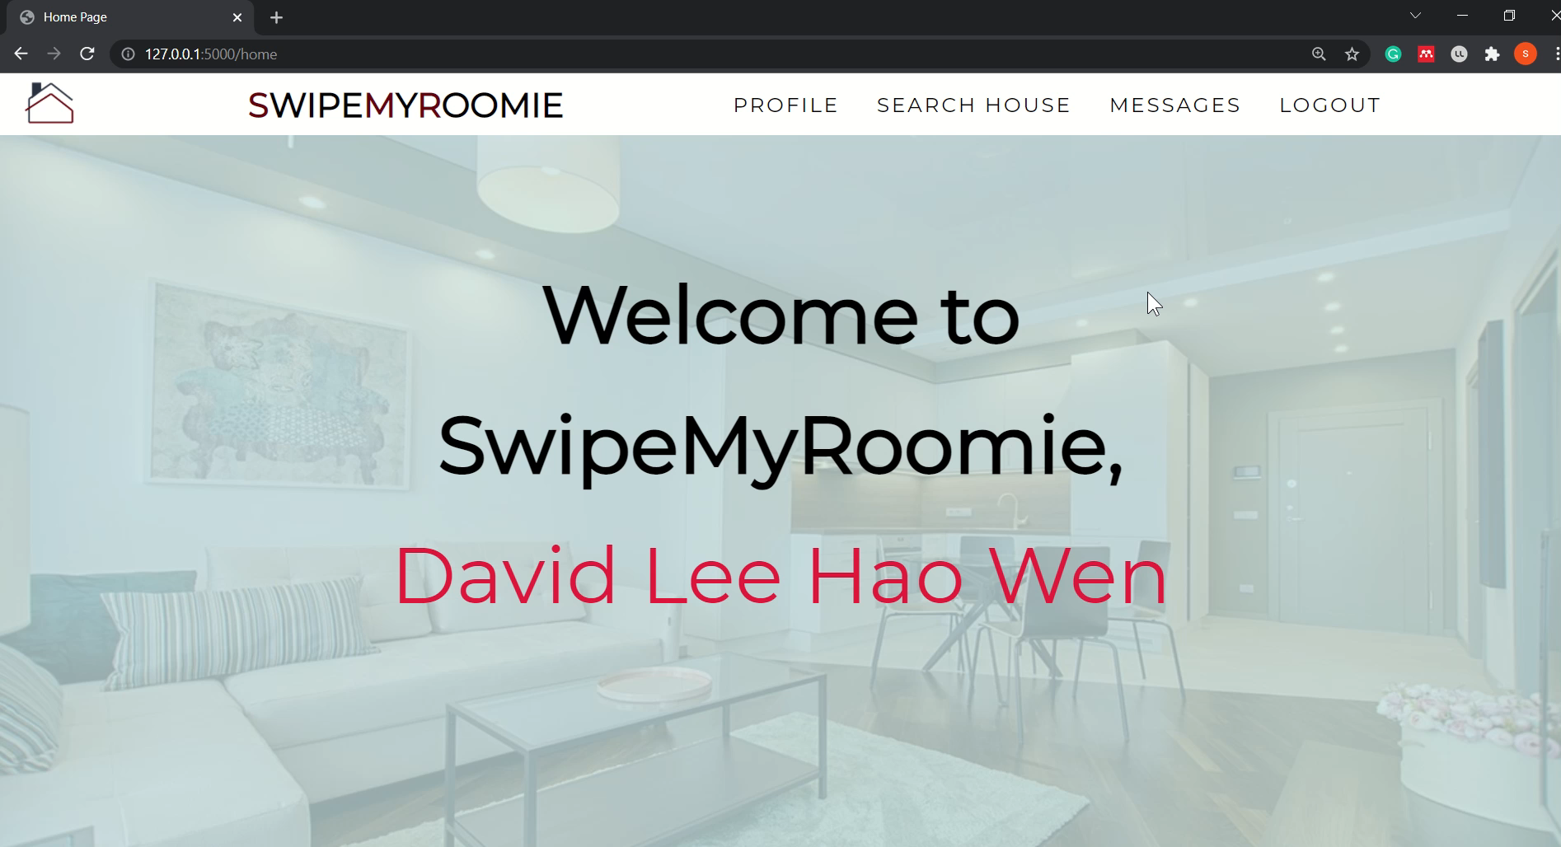
View Your Personal Details!
Notes:
Once inside, you can view your personal details. Here you can view your own details as well as your roommate preferences. You can even choose to update the roommate preference and your own self profile.

Slide 7
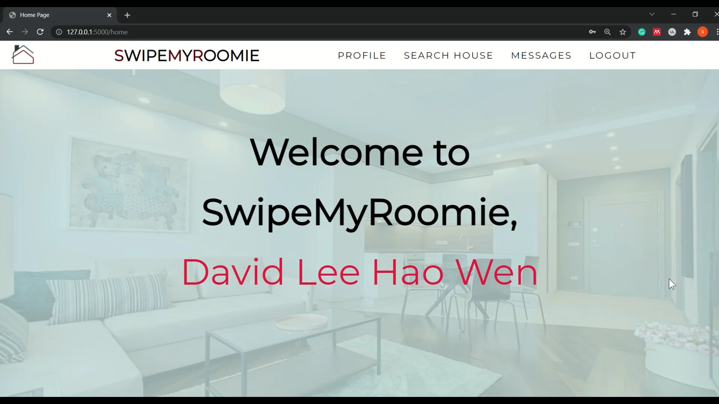
View Your Recommended Roomie!
Notes:
In our website you are even provided with a personalized roommate recommendation that was coded using the python pandas framework. You can click the right and left buttons to browse the various recommended profiles. You can even choose to skip a profile and you will no longer be recommended the profile again.

Slide 8
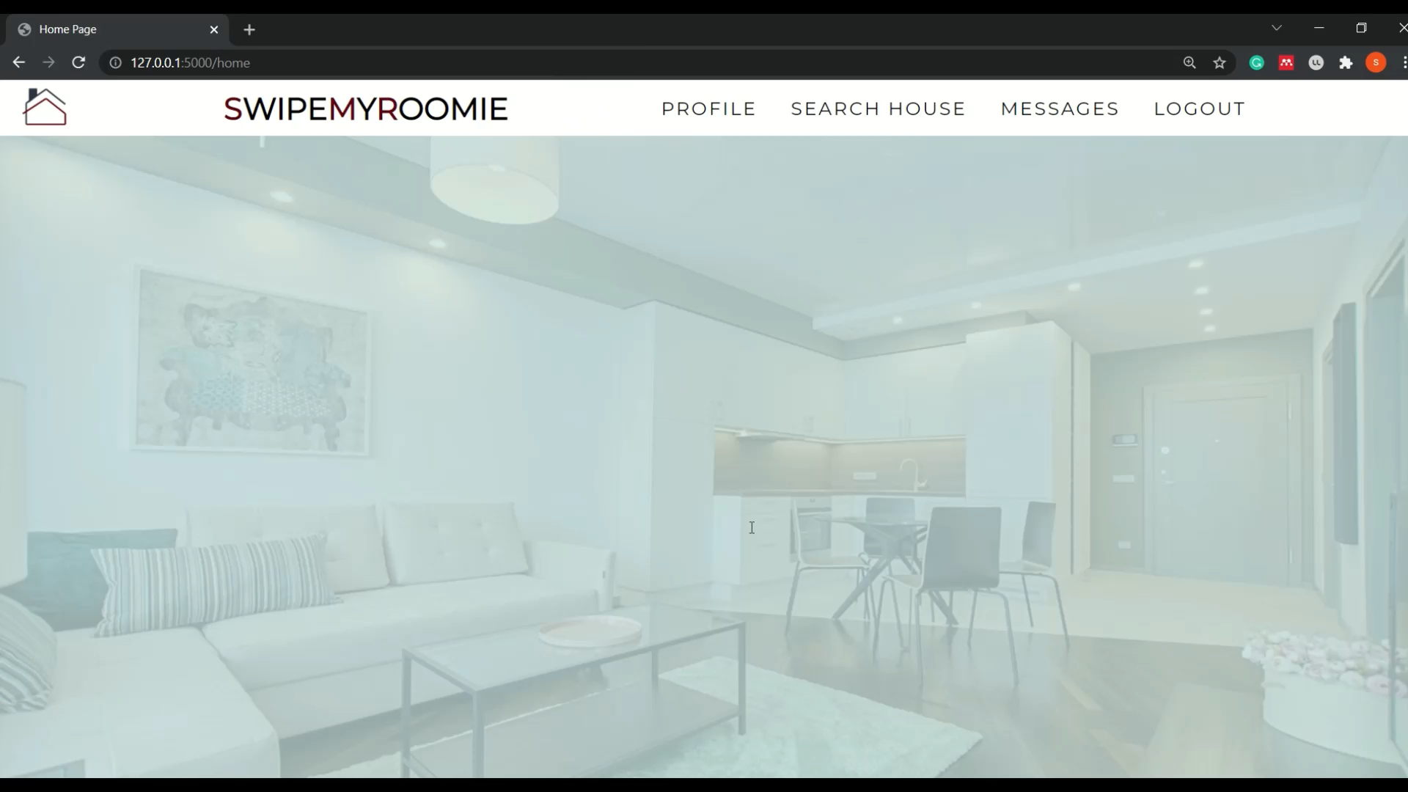

Message Your Potential Roomie!
Notes:
Now lets go on to message someone! Let’s pick Jason. We can view the message history. Additionally, number of people you have talked to can be viewed on the left hand side bar. Let’s chat with Jason and ask him to room with David in Hougang!

Slide 9
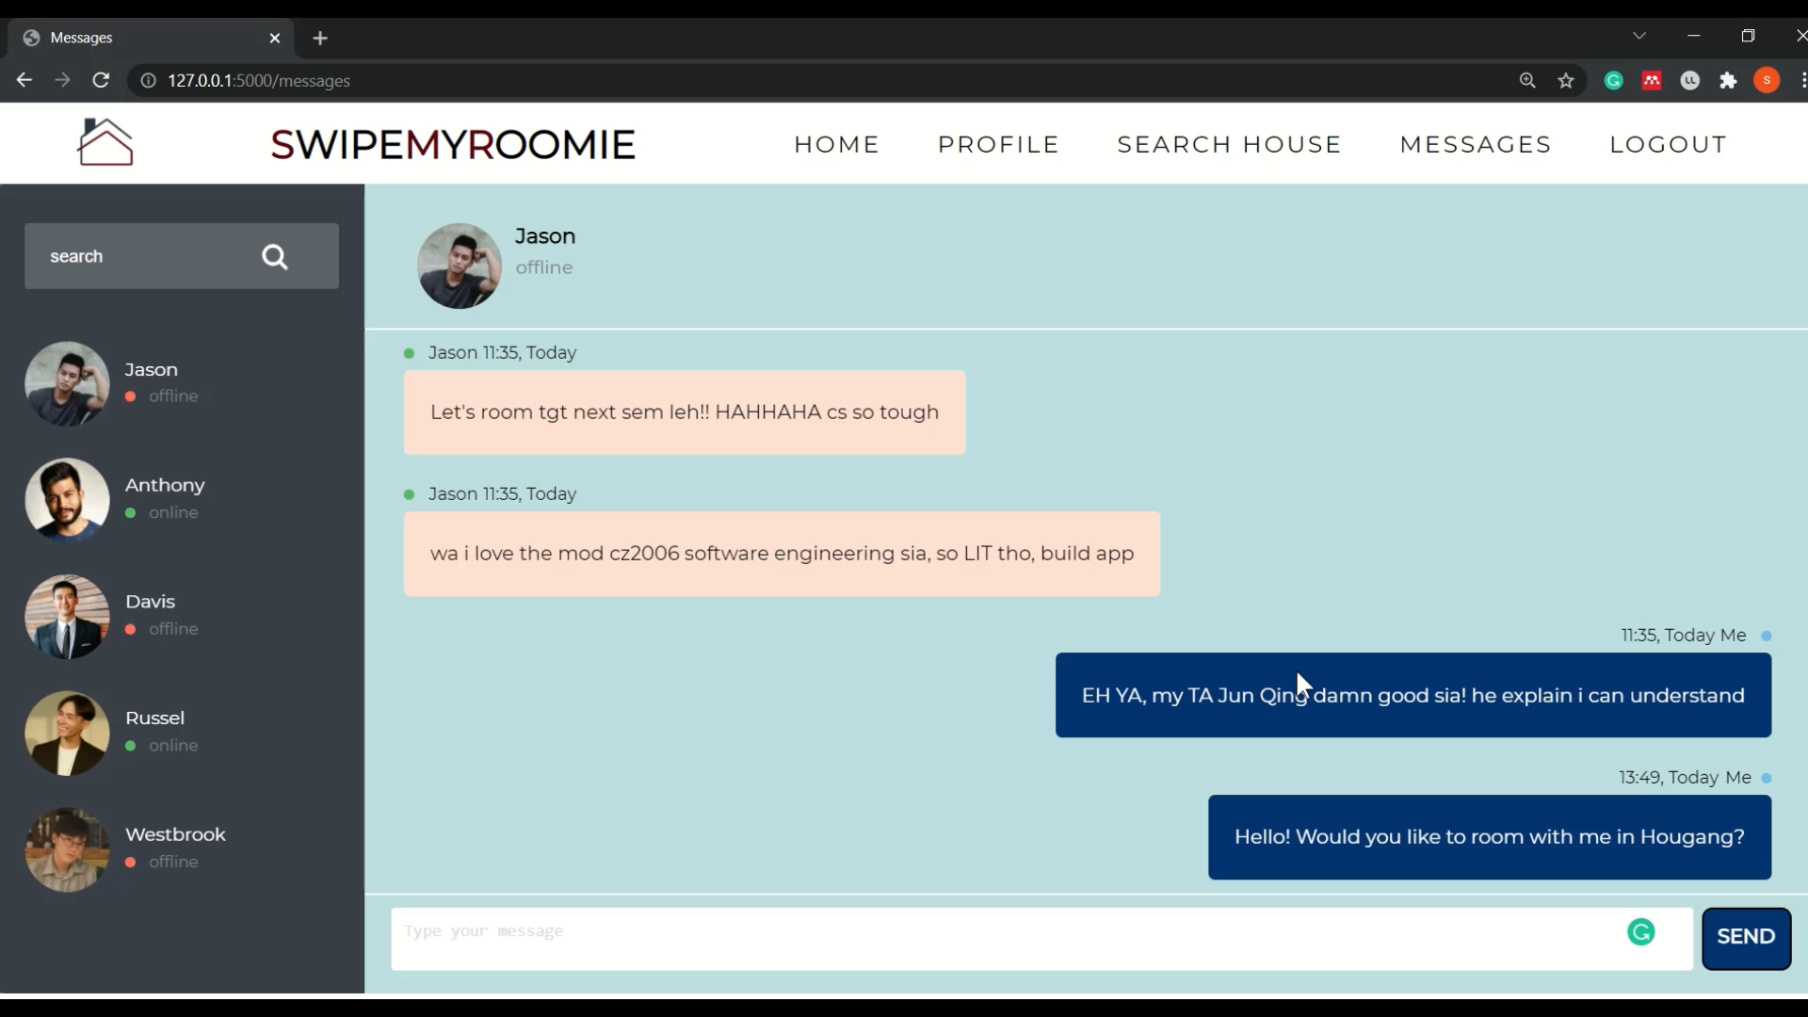
Search For Your House!
Notes:
Once you have decided to room in Hougang lets go to search the houses available on rent in Hougang!
Type in Hougang! Click the search bar and we will now be able to see a list of houses available to rent!
You can even see the amenitites like whether there is a market nearby, whether there is a multistorey carpark. You can see the complete date of the HDB as well!

Slide 10
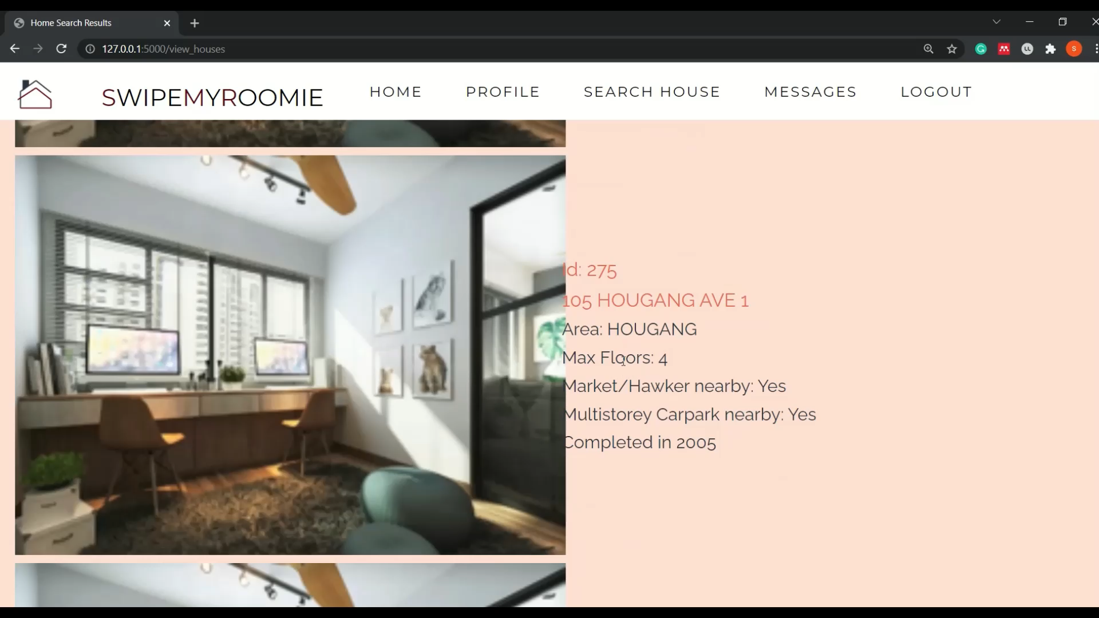
Let’s Logout Now…
Notes:
Once you log out you are redirected back to the main page.

Slide 11
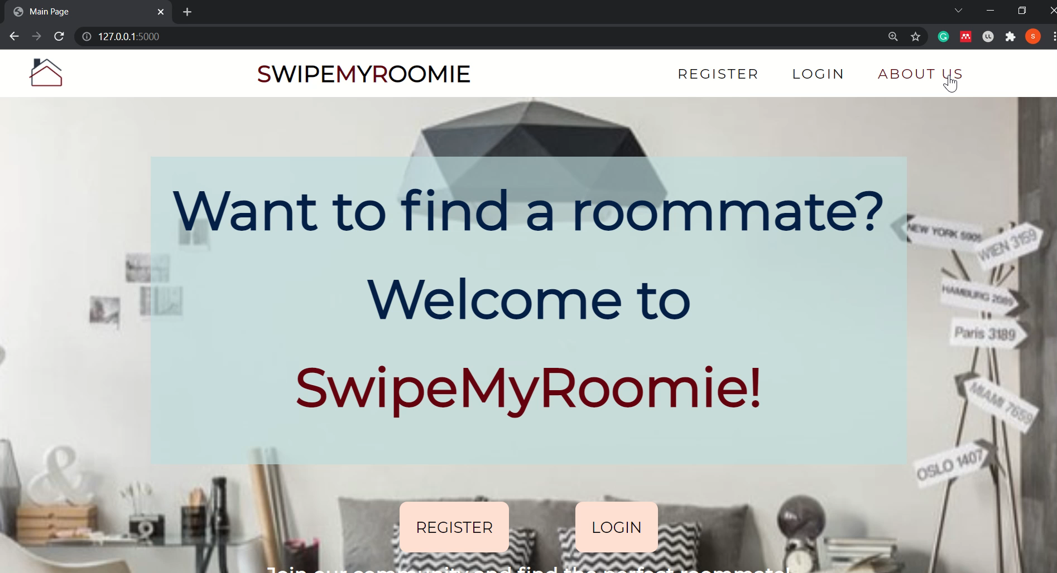
Want To Learn More?
Notes:
You can view more about us at the about page! Here we give details about what swipemyroomie is and how to use the website

Slide 12
So What Are You Wating For?
SwipeMyRoomie Now!

Slide 13











Technologies Used….

Slide 14
Brought To You By….
Team Alpha….
Sankar Samiksha
Poon Yan Xin Melise
Marcus NG Li Wang
Anagha Ani
Bansal Arushi
Ng Jun Han

